Slide 1

Customer Satisfaction Insights: NLP Analysis and Sentiment Prediction for Hotel Presented by Simona Sklenar

Slide 2
Project Overview
Objective:
.Use machine learning to develop a predictive model that can analyze customer reviews and identify key factors contributing to positive and negative sentiments.
Team Composition:
Lead Data Scientist: Simona Sklenar

Slide 3
Problem Statement
Problem Space:
The hospitality industry relies heavily on customer satisfaction to maintain competitive advantage. Guest reviews hold valuable insights into customer experiences, yet analyzing vast volumes of unstructured review text manually is inefficient, prone to bias, and can overlook critical feedback patterns.

Slide 4
Problem Statement
Objective:
Develop a scalable, machine learning-based model that can analyze guest reviews to predict customer satisfaction scores, identify key sentiment drivers, and enable hotel managers to make data-informed improvements to enhance the guest experience.

Slide 5
Challenges and Constraints
Sentiment Analysis: Accurately capture positive and negative sentiment patterns from diverse and unstructured review content.
Computational Efficiency: Process large datasets with limited computational resources, requiring optimized algorithms and model tuning.
Scalability: While we optimized for efficiency, the current model is not fully scalable for handling exponentially larger datasets. Scaling this solution would ideally involve deploying it in a cloud-based or distributed processing environment.
Interpretability: Ensure model outputs are easily understood and actionable for non-technical hotel managers aiming to enhance customer satisfaction.

Slide 6
Approach
Exploratory Data Analysis (EDA):
Exploratory Data Analysis (EDA):Conducted a thorough EDA to identify patterns and trends in the data, gaining initial insights into factors influencing customer sentiment.
Analyzed distributions, correlations, and key features to understand how specific attributes relate to positive or negative reviews.
Model Building:
Developed and evaluated a variety of models for sentiment prediction:
Logistic Regression to establish a baseline for binary classification.
Decision Tree to capture nonlinear relationships and feature interactions.
Random Forest for improved accuracy through ensemble learning.
Gradient Boosting to maximize predictive performance through sequential learning.

Slide 7
Approach
Feature Importance Extraction:
Analyzed top features from the models to identify influential words and characteristics driving sentiment.
Leveraged key terms and attributes from high-impact features to gain insights into customer preferences and areas needing improvement.
Actionable Insights for Hotel Experience Improvement:
Used findings from the model’s top features to suggest actionable steps for enhancing hotel services.
Provided recommendations based on prominent feedback themes to improve guest satisfaction and address common concerns..

Slide 8
Data Overview: Key Features and Structure
Source and Format:
The dataset is an Excel file from Hospitality Insights Group, provided by BrainStation.
Contains 515,738 instances and 29 features, offering a comprehensive look at factors influencing customer satisfaction and hotel ratings.

Slide 9
Data Overview: Key Features and Structure
Source and Format:
The dataset is an Excel file from Hospitality Insights Group, provided by BrainStation.
Contains 515,738 instances and 29 features, offering a comprehensive look at factors influencing customer satisfaction and hotel ratings.

Slide 10
Data Overview: Key Features and Structure
Feature Composition:
Binary Features: 11 binary variables representing categorical attributes, such as nationality indicators or indicating trip type.
Numerical Features: 10 continuous variables representing quantitative aspects, such as average rating scores, review word counts, and geographical coordinates.
Text Features: Two text-based columns, one capturing positive comments and the other capturing negative comments, from guests about their experiences, enabling sentiment analysis and NLP-driven insights.

Slide 11
Data Overview: Key Features and Structure
Data Relevance:
The dataset provides a balanced mix of numerical, categorical, and text data, making it suitable for building machine learning models for classification and sentiment analysis.
Each row represents a unique hotel stay, capturing various aspects of the guest experience in a structured format.

Slide 12
Data Overview: Key Features
Analytical Opportunities:
The inclusion of review content in text format supports NLP applications, allowing for analysis of word patterns and sentiment indicators.
Enables the identification of key drivers behind positive and negative reviews, which can guide business improvements in customer satisfaction.

Slide 13
Data Dictionary
additional_number_of_scoring | The number of additional scores given for the hotel.
average_score | The average score of the hotel based on reviews.
days_since_review | The number of days since the review was posted.
day | Day of the review.
hotel_address_amsterdam | Binary variable indicating if the hotel is located in Amsterdam.
hotel_address_barcelona | Binary variable indicating if the hotel is located in Barcelona.
hotel_address_london | Binary variable indicating if the hotel is located in London.
hotel_address_milan | Binary variable indicating if the hotel is located in Milan.
hotel_address_paris | Binary variable indicating if the hotel is located in Paris.
hotel_address_vienna | Binary variable indicating if the hotel is located in Vienna.

Slide 14
Data Dictionary
latitude | Latitude coordinate of the hotel's location.
leisure_trip | Binary variable indicating if the trip was for leisure or not.
longitude | Longitude coordinate of the hotel's location.
month | Month of the review.
negative_review | Textual field containing negative comments from the reviewer.
nights_stayed | The number of nights the reviewer stayed at the hotel.
positive_review | Textual field containing positive comments from the reviewer.
review_total_negative_word_counts | Total count of negative words in the negative review.
review_total_positive_word_counts | Total count of positive words in the positive review.
reviewer_nationality_australia | Binary variable indicating if the reviewer is from Australia.

Slide 15
Data Dictionary
reviewer_nationality_ireland | Binary variable indicating if the reviewer is from Ireland.
reviewer_nationality_other | Binary variable indicating if the reviewer is from a nationality other than the specified ones.
reviewer_nationality_uae | Binary variable indicating if the reviewer is from the UAE (United Arab Emirates).
reviewer_nationality_uk | Binary variable indicating if the reviewer is from the UK (United Kingdom).
reviewer_nationality_usa | Binary variable indicating if the reviewer is from the USA (United States of America).
reviewer_score | The score given by the reviewer, where positive sentiment is encoded as 1 and negative as 0.
total_number_of_reviews | The total number of reviews for the hotel.
total_number_of_reviews_reviewer_has_given | The total number of reviews the reviewer has given.
year | Year of the review.

Slide 16
EDA Overview
Our EDA approach includes:
Distribution Analysis: Examining the spread and variability of numerical and categorical features to identify patterns and outliers.
Geospatial Analysis: Investigating geographic influences on customer sentiment by mapping review distributions across locations.
Sentiment Analysis: Analyzing positive and negative customer reviews to uncover key drivers of satisfaction and dissatisfaction.
Correlation Analysis: Evaluating feature correlations to understand dependencies and highlight potential predictors.
Statistical Redundancy Analysis: Identifying redundant features through statistical testing to streamline the model’s input data.

Slide 17
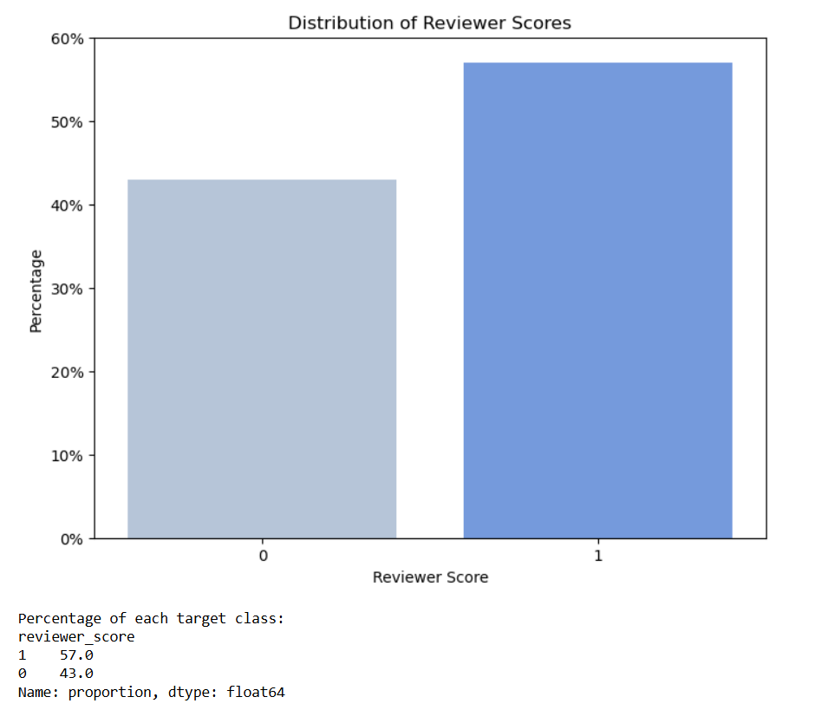
Target Variable Distribution
Our target feature is reviewer_score (binary variable) where 0 represents a negative sentiment and 1 represents a positive sentiment.
The distribution of the reviewer_score is split 57/43, with positive reviews slightly more prevalent.
Although the split indicates class imbalance, the size of the split is not substantial.

Slide 18
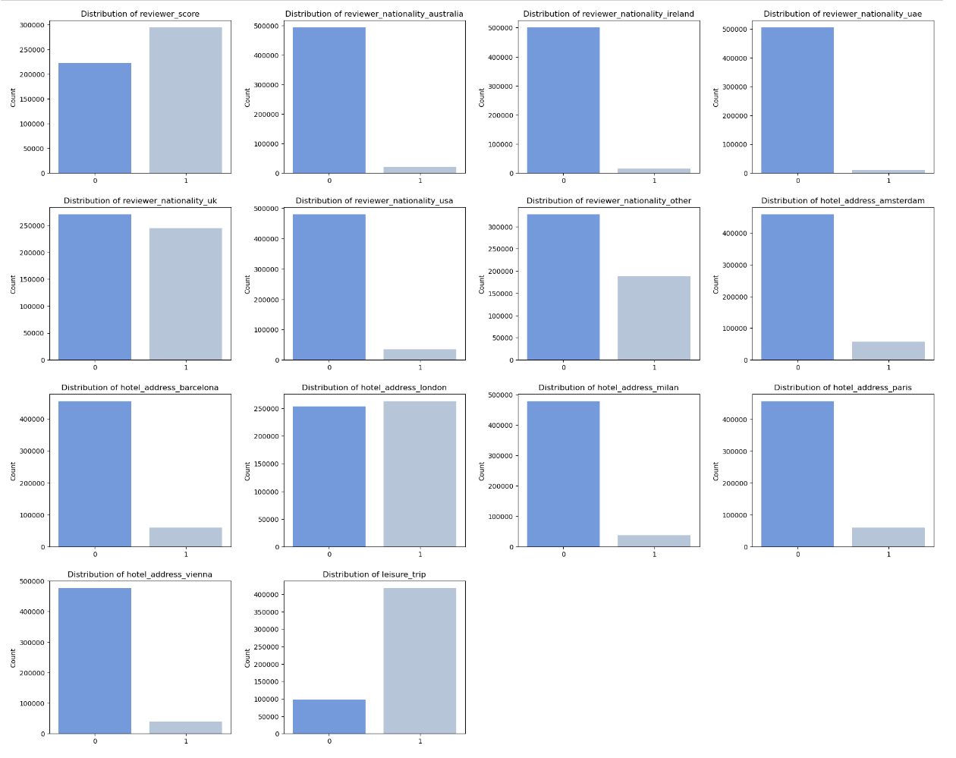
Distribution of Binary Features
Most reviewers are categorized as other.
Most trips are for leisure.
Most reviews are for hotels in London, followed by Paris.

Slide 19
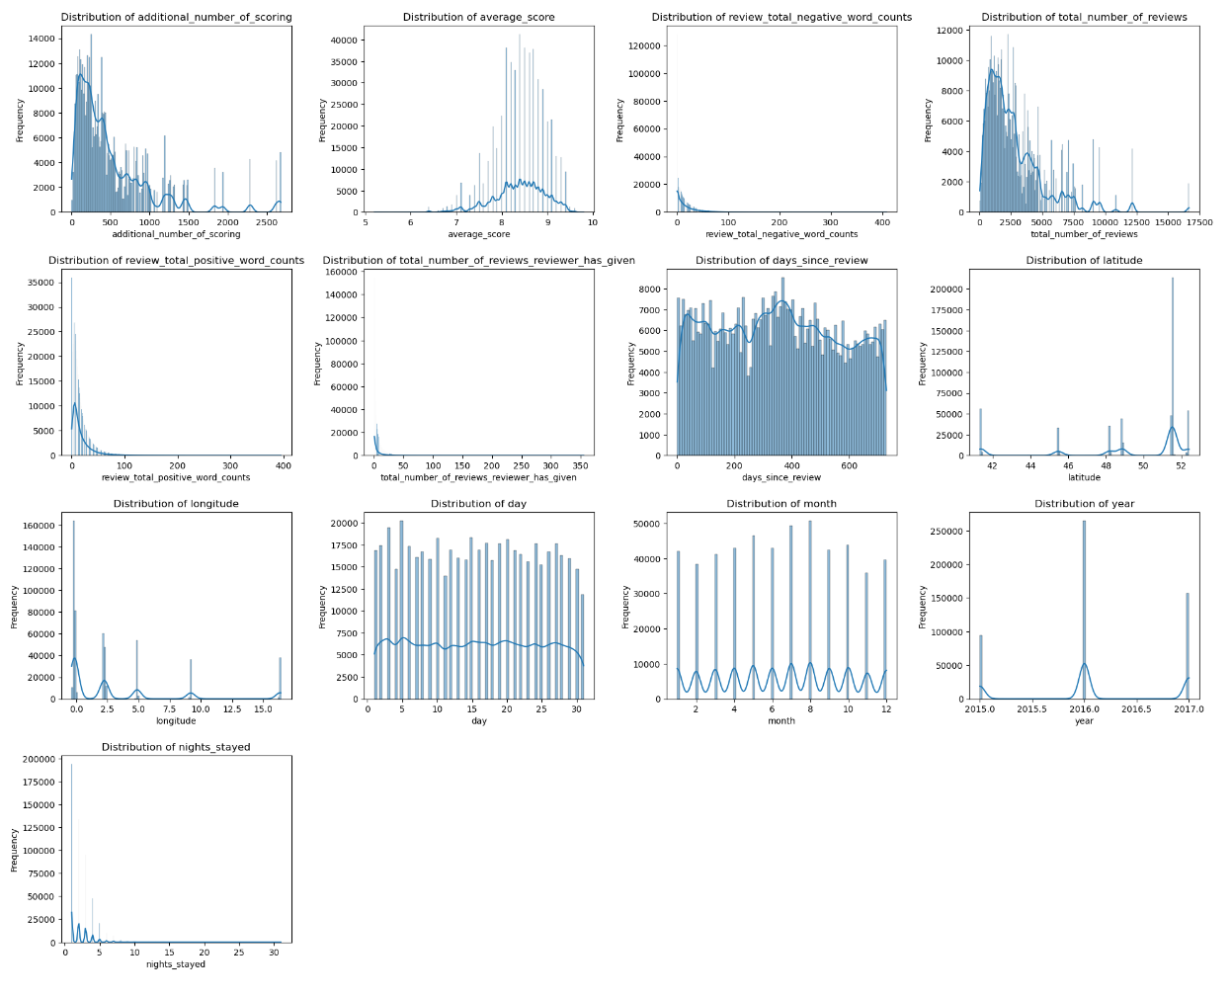
Distribution of Numerical Features
Several features, such as additional_number_of_scoring and nights_stayed, show right-skewed distributions.
Features such as day and days_since_review, have uniform distributions.
month and year have peaks and spikes.
total_number_of_reviews_reviewer_has_given shows a concentration of low values with a long tail, indicating that most reviewers contribute only a few reviews

Slide 20
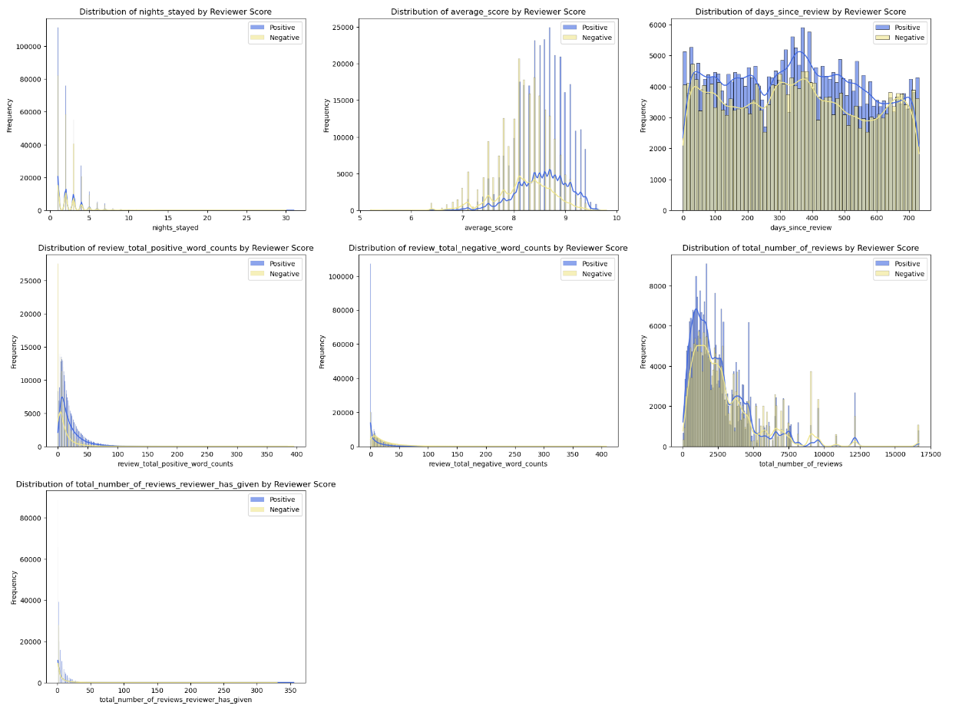
Numerical Variable Distribution by Reviewer Score
average_score has positive reviews cluster around higher scores (8–10), while negative reviews are more spread across lower scores, potentially making this a strong predictor of sentiment.
Negative reviews consistently contain higher negative word counts, with positive reviews showing minimal counts.
Positive reviews have higher positive word counts although there is overlap with negative reviews.

Slide 21
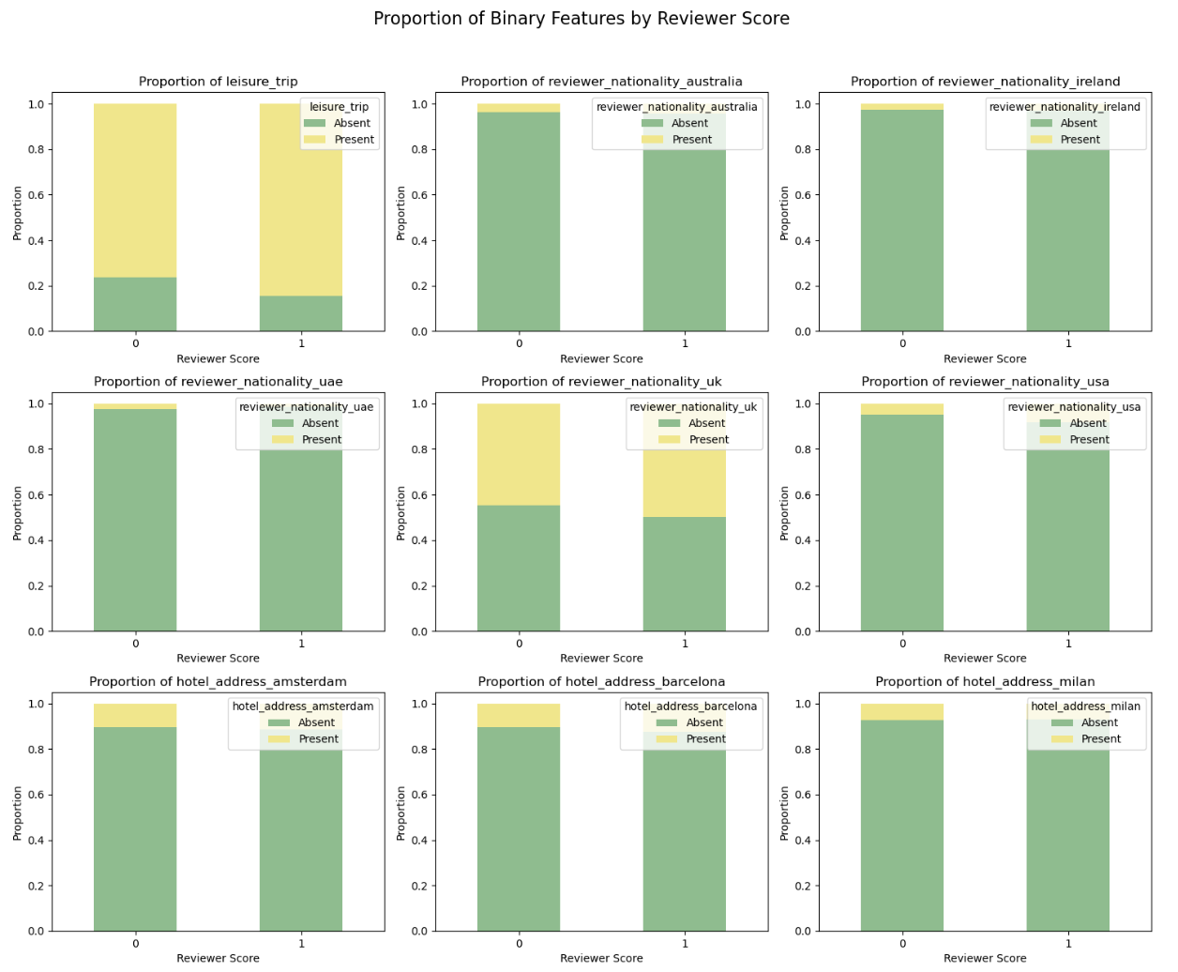
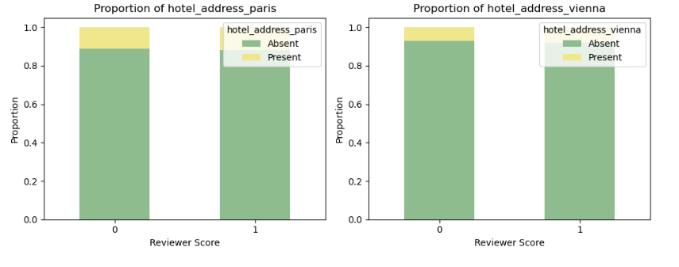
Proportion of Binary Features by Reviewer Score

Slide 22
Proportion of Binary Features by Reviewer Score
The majority of reviews are from leisure trips and this trend is consistent for both positive and negative reviews. However, positive reviews have a slightly higher proportion of leisure trips, suggesting that people on leisure trips might be more satisfied with their experience.
The majority of reviewers are from the UK and they tend to give more positive scores compared to other nationalities.
Other Nationalities have very few reviews, but a high proportion of these reviews have positive scores.

Slide 23
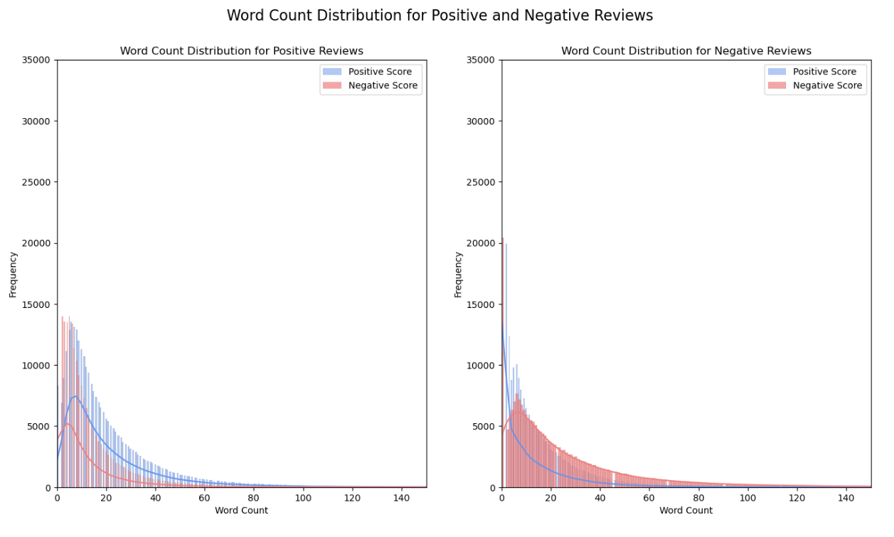
Word Count Distribution for Positive and Negative Reviews
Both distributions are heavily right-skewed, with most of the reviews (both positive and negative) having low word counts. This implies that most users tend to write shorter reviews, regardless of the review’s sentiment.

Slide 24
Sentiment Analysis of Review Content as an Indicator of Reviewer Score
Using Text Blob, we found that only 41.04% of reviews with a reviewer score of 1 exhibit positive sentiment and 5.32% of reviews with a reviewer score of 0 exhibit negative sentiment.
These findings imply that reviewer score likely incorporates factors beyond the sentiment expressed in review texts.
However, despite this misalignment, it remains valuable to include the review text in our model.

Slide 25
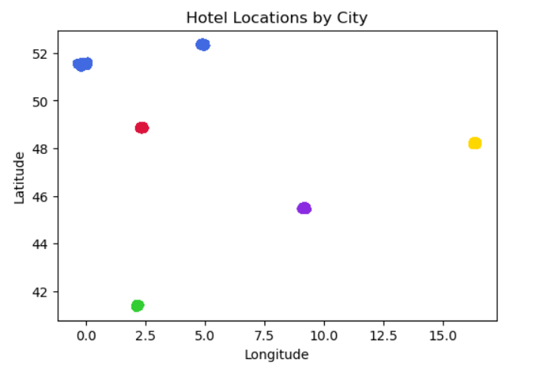
Geospatial Analysis: Mapping Hotels by City
The mapping of hotel locations by city shows clear separation among cities, with distinct clusters for each location.
This visualization suggests that each city’s hotels are geographically isolated, suggesting that latitude and longitude alone could potentially replace the hotel address features.

Slide 26
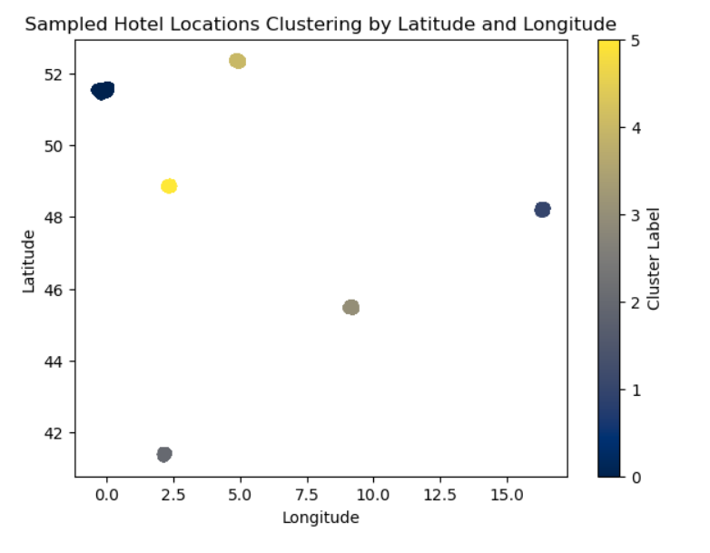
Geospatial Analysis: KMeans Clustering
The clustering results reveal distinct geographic groupings, where each cluster likely represents a unique city (or region).
Since the clusters seem to align well with geographic regions, the hotel address binary features may be redundant.
This suggest that we can drop hotel address columns since longitude and latitude coordinates preserve location information.

Slide 27
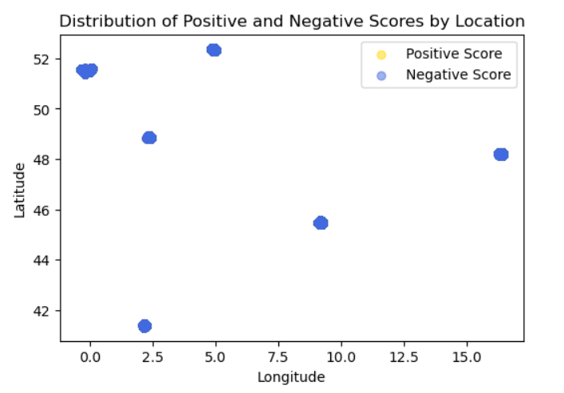
Reviewer Score by Location
The overlap of positive and negative scores suggest that positive and negative scores are distributed almost identically within each location cluster.
This implies that sentiment does not vary significantly based on location alone.

Slide 28
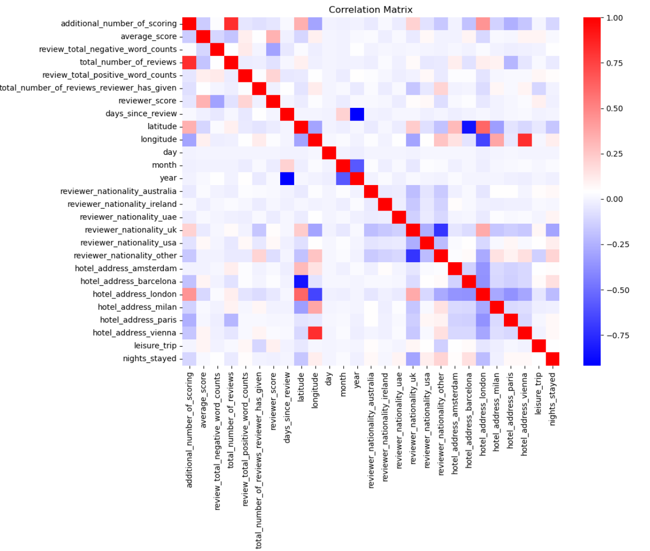
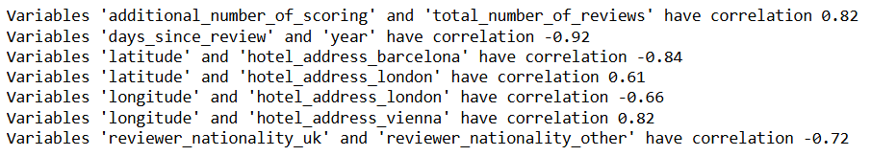
Correlation Analysis: Correlation Matrix of Numerical Features
As expected, latitude and longitude are highly correlated with various hotel address locations.
There is a strong negative correlation between the days since a review and year. This suggest that more recent reviews are associated with higher years.

Slide 29
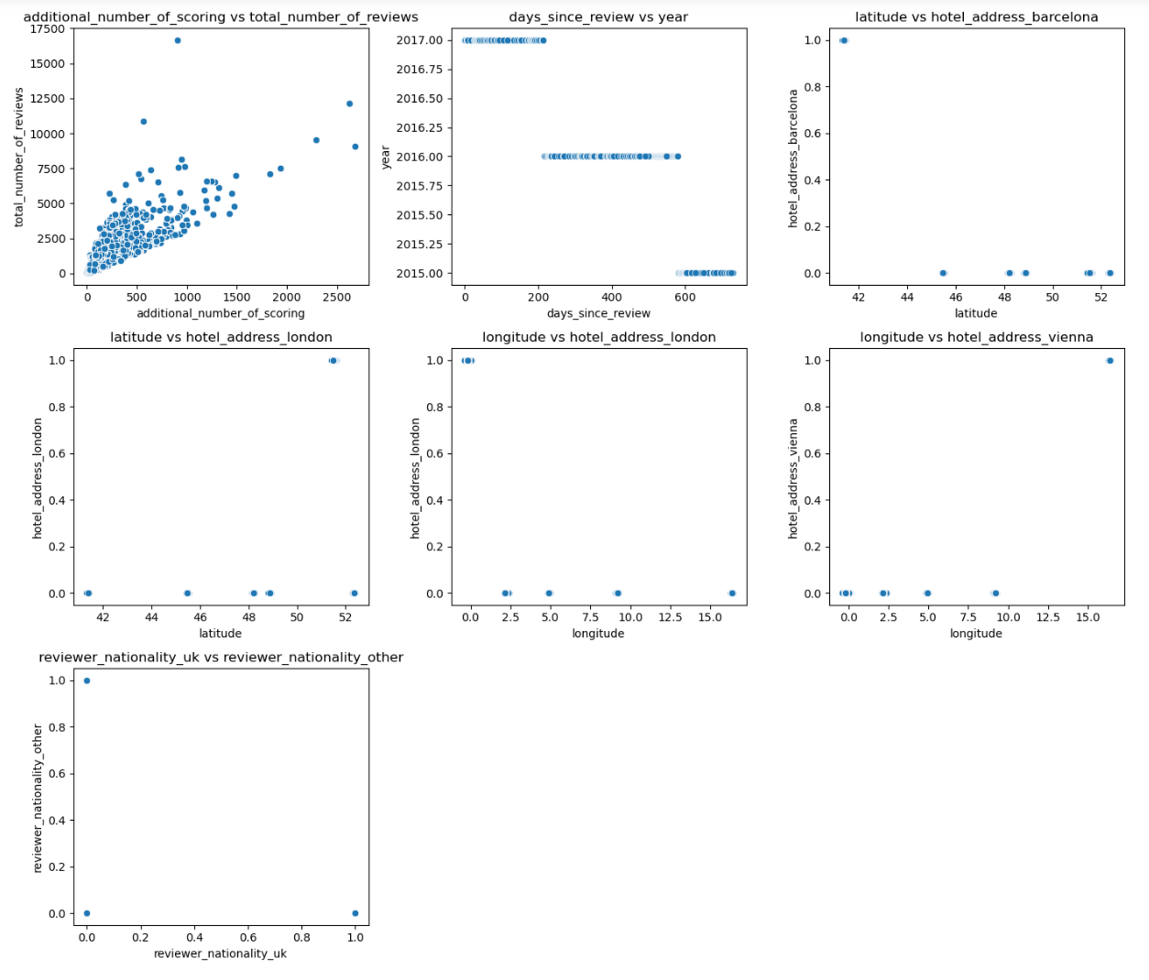
Scatterplot of Highly Correlated Pairs
There is a strong positive linear relationship between additional_number_of_scoring and total_number_of_reviews.
This positive correlation suggests that hotels with more reviews also tend to have more additional scores, indicating a relationship between general engagement and detailed scoring.
This could imply that guests are more likely to provide additional scores for hotels that already have a high volume of reviews.

Slide 30
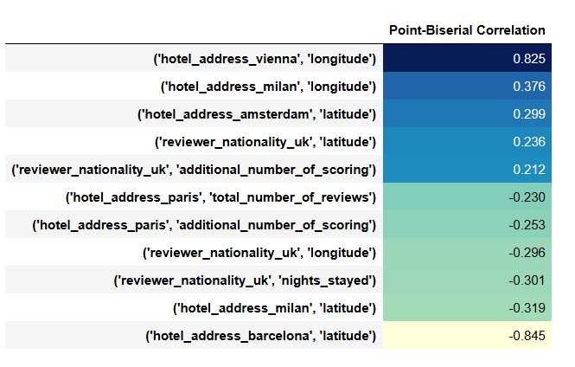
Point-Biserial Correlation
Again, the analysis suggests that we should drop all hotel addresses but retain the longitude and latitude features.

Slide 31
Logistic Regression for Sentiment Prediction
We started with logistic regression as a baseline model for predicting sentiment.
We chose the logistic model because it is a good tool for binary classification tasks, making it suitable for predicting positive or negative sentiment in reviews.
Despite the absence of strong linear relationships in our features, logistic regression is effective because it does not require features to have strict linear correlations with the target.
The key to making this model work is to properly prepare and preprocess the text features. For each of the logistic models, we first applied our own custom tokenizer, then combined both the positive and negative words into a combined review column, and then we vectorized the column.

Slide 32
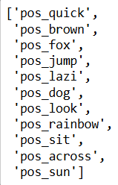
Custom Text Tokenizer
A tokenizer is essential in NLP because it breaks down text into individual words or sub-words (tokens), enabling the model to analyze and process the language more effectively.
We created our own custom tokenizer to feed our text features into. Our tokenizer:
Splits sentences into individual words for detailed analysis.
Removes special characters and filters out non-informative stop words to focus on relevant content.
Applies both stemming and lemmatization to reduce words to their core forms while retaining context
Adds the prefixes pos_ and neg_ to distinguish between positive and negative feedback.
The figure in this the output of putting in the text 'The quick brown fox jumps over the lazy dog that is looking at the rainbow, sitting across the Sun!’ with the pos_ prefix.

Slide 33
Merging Text Columns and Data Splitting
As mentioned in the previous slide, we combine positive_review and negative_review into a single column called combined_review. This consolidated text column will simplify our dataset, allowing us to analyze both positive and negative sentiments within one corpus.
The combined text also provides a more comprehensive view of customer feedback, encompassing both favorable and unfavorable aspects.
After the creation of combined_review, we dropped positive_review and negative_review features from our dataset.
We split our dataset into training, validation, and test sets following a 60/20/20 split. This setup allows us to use 60% of the data for model training, 20% for validation, and 20% for testing the model's generalizability on unseen data.

Slide 34
Vectorizing Text Features and Concatenating Processed Datasets
We used CountVectorizer to convert the combined_review text column into vectorized features.
We limited to a maximum of 500 vectorized features to balance model complexity and interpretability.
After the fitting and transformation, we dropped our combined_review feature, so that our dataset has no text valued features.
Our dataset was now ready for training, validation and testing.

Slide 35
Vectorizing Text Features and Concatenating Processed Datasets
We used CountVectorizer to convert the combined_review text column into vectorized features.
We limited to a maximum of 500 vectorized features to balance model complexity and interpretability.
After the fitting and transformation, we dropped our combined_review feature, so that our dataset has no text valued features.
Our dataset was now ready for training, validation and testing.

Slide 36
Baseline Logistic Model
To ensure reliable results, we have chosen the following parameters, previous experimentation (we will not recreate this as it took several days for the code to run):
Iterations and Solver: With the default maximum iterations, the model’s coefficients did not converge. After experimentation, we set max_iter to 5000 and selected the sag solver, which provided balanced train and test accuracies with a manageable runtime.
Regularization Parameter (C): Through a time-intensive GridSearch, we identified that C=0.1 offered optimal results.
Regularization Choice: The sag solver defaults to l2 regularization and does not support l1, so we exclusively use the l2 penalty.

Slide 37
Feature Selected Logistic Model
From our exploratory data analysis (EDA), we identified features that were either redundant or highly correlated with others, which could introduce noise and diminish the model’s predictive power.
By dropping these features, we create a leaner dataset that maintains essential information for prediction without unnecessary overlap.
We also apply transformations, such as log scaling on skewed features, to normalize their distributions.
We applied the same parameters as we did for our logistic model.

Slide 38
TF-IDF Logistic Model
We applied Term Frequency-Inverse Document Frequency (TF-IDF) vectorization to our dataset as a part of our feature engineering process.
TF-IDF is a statistical technique commonly used in Natural Language Processing (NLP) to transform text data into numerical representations, capturing the importance of each word within the review text. By weighting words based on their frequency and uniqueness across reviews, TF-IDF allows us to quantify the contribution of individual terms more effectively, thus enhancing the model’s understanding of sentiment-driven patterns.
This approach was especially useful here since our initial exploratory analysis revealed that using generic sentiment scoring tools like TextBlob was not well-aligned with the actual review sentiment labels. Splitting the positive and negative reviews and applying TF-IDF vectorization allows us to better capture the distinct patterns in each sentiment type.

Slide 39
Logistic Model with N-Gram (1,2) and (1,3) Range
We continued to experiment with two different ngram_range values and evaluated their impact on model performance.
Bigrams (adjacent pairs of words) and trigrams (sequences of three consecutive words) can capture more conceptual information and potentially improve model performance.
Including bigrams or trigrams can help capture common phrases or expressions that may better reflect the sentiment or specific content of the reviews. By gathering phrases, n-grams can help the model recognize combinations of words that convey meaning beyond individual terms. For example, the phrase "not good" conveys a negative sentiment that a unigram model might miss if it only sees "not" and "good" separately.

Slide 40
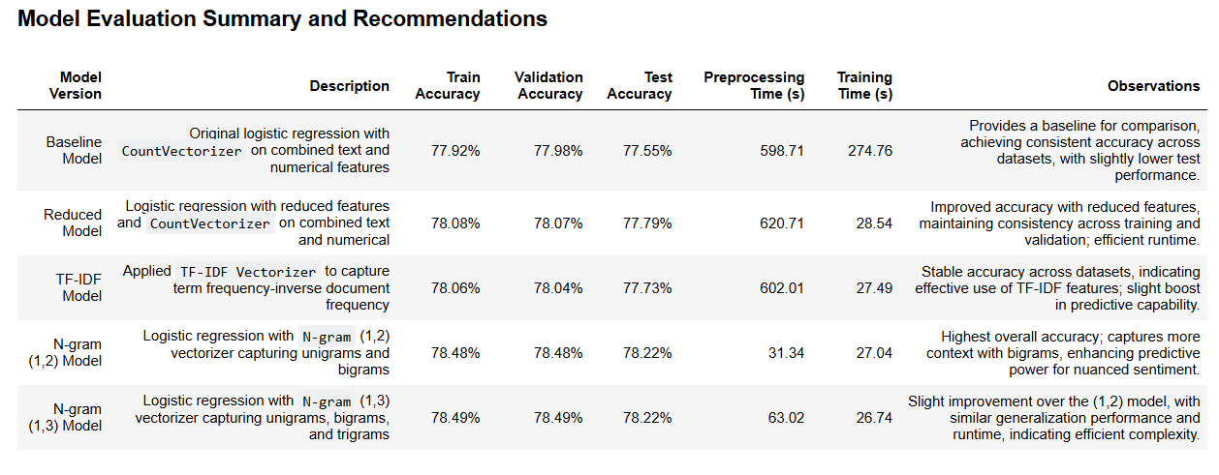
Logistic Model Evaluation Summary

Slide 41
Logistic Model Evaluation Summary
Best Model: The N-gram (1,3) Model achieved the highest accuracy, indicating that trigrams captured richer context in customer reviews, improving sentiment prediction.
Runtime: Despite the longer preprocessing time for the N-gram (1,3) model, it remained efficient during training and balanced between predictive accuracy and interpretability.
Generalization: All models displayed strong generalization, with minimal differences between validation and test accuracies, showing reliable performance across unseen data.
Recommendation: Given its superior accuracy and balance in runtime, the N-gram (1,3) Model is recommended for deployment, potentially further enhancing insights by examining top feature words.

Slide 42
Decision Tree Analysis with Dimensionality Reduction and Optimized Hyperparameters
Decision trees are widely recognized for their interpretability and hierarchical structure, which helps to uncover significant patterns within the data. However, they are also prone to overfitting, which necessitates careful tuning of hyperparameters such as max_depth, min_samples_split, and min_samples_leaf.
We applied a decision tree classifier to our dataset using the top-performing features identified during feature selection and dimensionality reduction through PCA.
To balance performance optimization with computational efficiency, we utilized a randomized search to quickly identify promising hyperparameter combinations. This technique allowed us to focus computational resources on a subset of possible parameters.

Slide 43
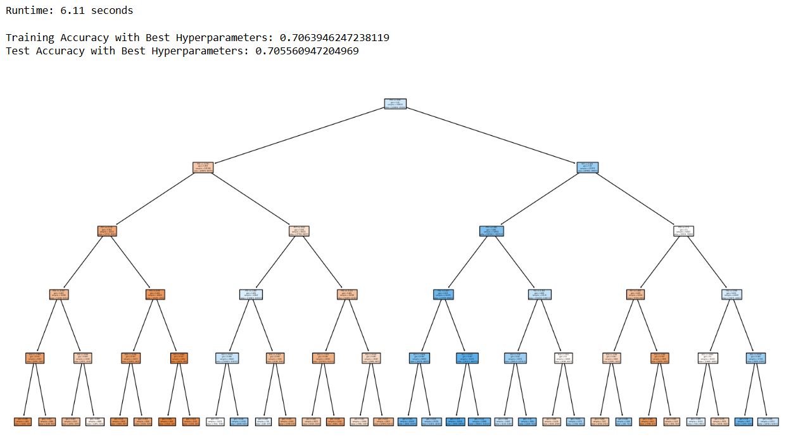
Decision Tree Model Evaluation

Slide 44
Decision Tree Model Evaluation
Runtime for the decision tree model was exceptionally fast at less than 7 seconds.
Training and Test Accuracy scores were almost equal, signifying a lack of overfitting and the model’s ability to generalize effectively on completely seen data.
However, the decision tree model under performed at 70% which is an 8% decrease from our N-gram (1,2) model.

Slide 45
Random Forest Analysis with Optimized Hyperparameters
Random Forests is an ensemble learning method that combines multiple decision trees to enhance predictive accuracy and model stability. This approach uses the principle of averaging or "bagging" predictions from individual decision trees, each trained on a random subset of data and features, to produce a more robust final model.
We implemented a Random Forest Classifier with optimized hyperparameters on a reduced dataset. To optimize training efficiency and model performance, we first performed a Randomized Search to identify the ideal hyperparameters for the Random Forest model.
Although a full Grid Search could explore every possible parameter combination exhaustively, the Randomized Search offers a time-efficient alternative by evaluating a specified number of random configurations across a set range. This balance between thoroughness and efficiency made it well-suited to the needs of this experiment.

Slide 46
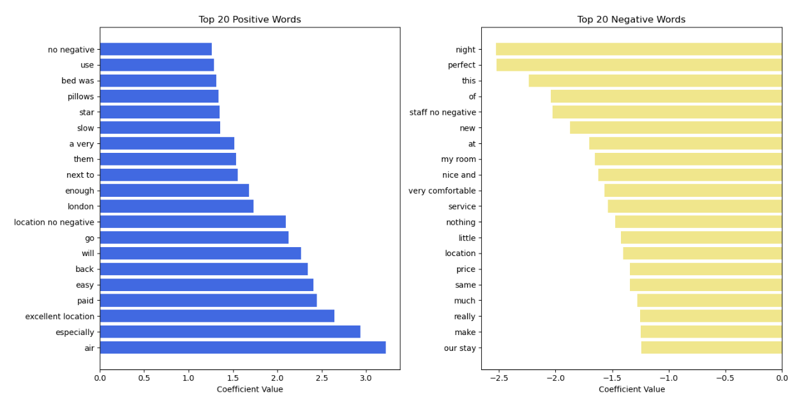
Feature Analysis n-grams(1,3) Logistic Model

Slide 47
Feature Analysis n-grams(1,3) Logistic Model
Positive Sentiment Drivers: Key phrases like "excellent location," "free," and "comfortable" indicate high guest satisfaction related to location and room amenities.
Negative Sentiment Indicators: Words like "disappoint," "distance," and "price" signal common guest complaints about value and location.
Actionable Patterns: Captures sentiment-driven language patterns, which can inform targeted marketing around positive features and improvements on negative areas.

Slide 48
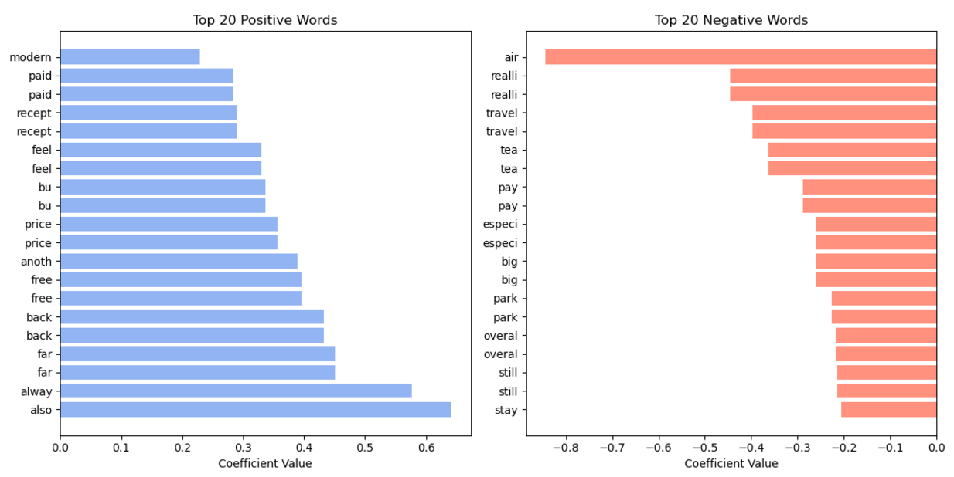
Feature Analysis from Reduced Logistic Model

Slide 49
Feature Analysis from Reduced Logistic Model
Focus on Value and Service: Frequent terms like price, service, and staff indicate that guest sentiment is heavily influenced by perceived value and staff interactions.
Room Comfort Features: Words such as modern and reception reinforce the importance of comfort and smooth check-in/check-out experiences.
Strategic Marketing Potential: Highlights areas where promotional efforts on service quality and room features could enhance perceived value.

Slide 50
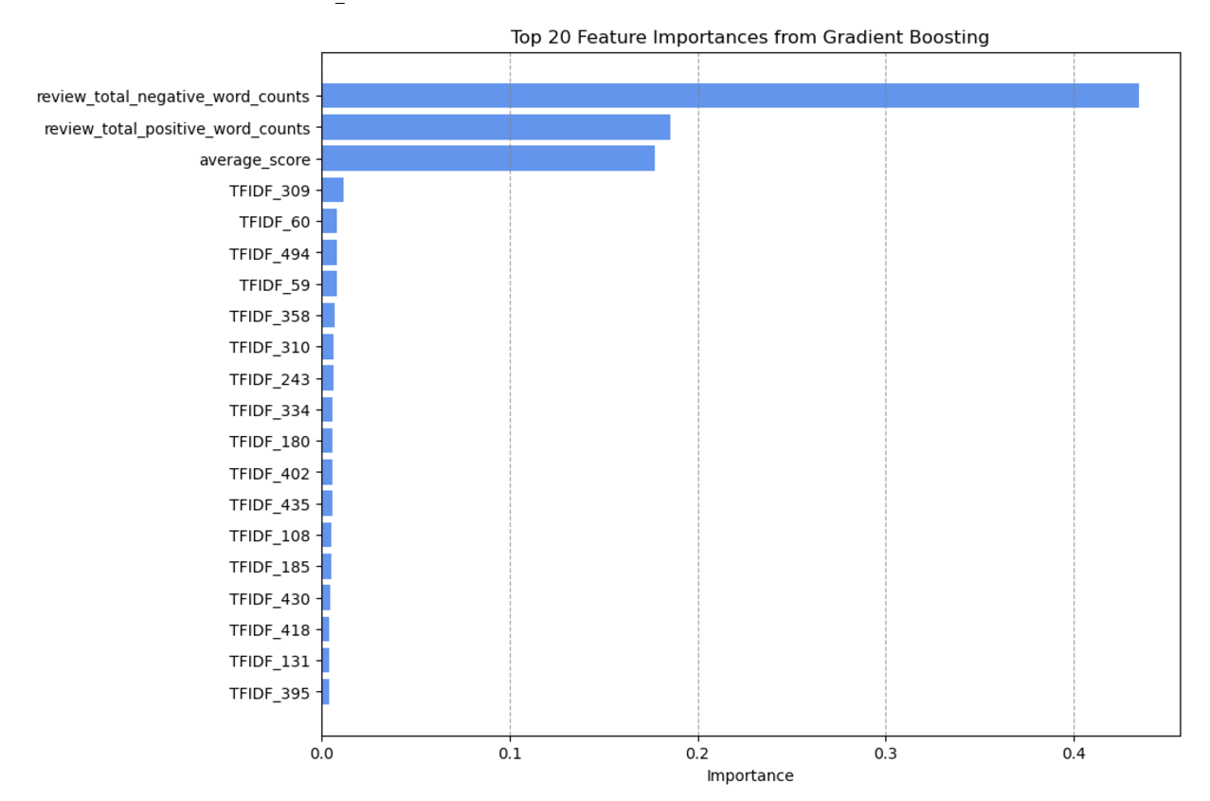
Feature Analysis from Gradient Boosting Model

Slide 51
Feature Analysis from Gradient Boosting Model
High-Impact Numerical Features: Total positive/negative word counts, and average score are top contributors, indicating that review details are strong sentiment predictors.
Important TF-IDF Terms: Words like pos_disappoint and neg_distance reflect guest priorities related to location and experience.
Predictive Strength in Details: Shows that detailed reviews are highly predictive, suggesting a focus on addressing specific feedback.

Slide 52
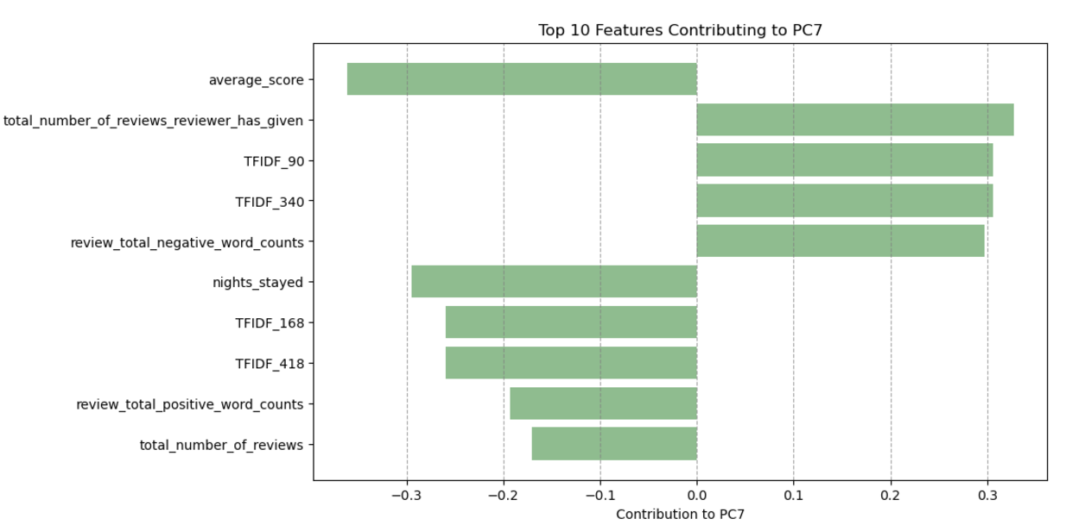
Feature Analysis from Decision Tree Model

Slide 53
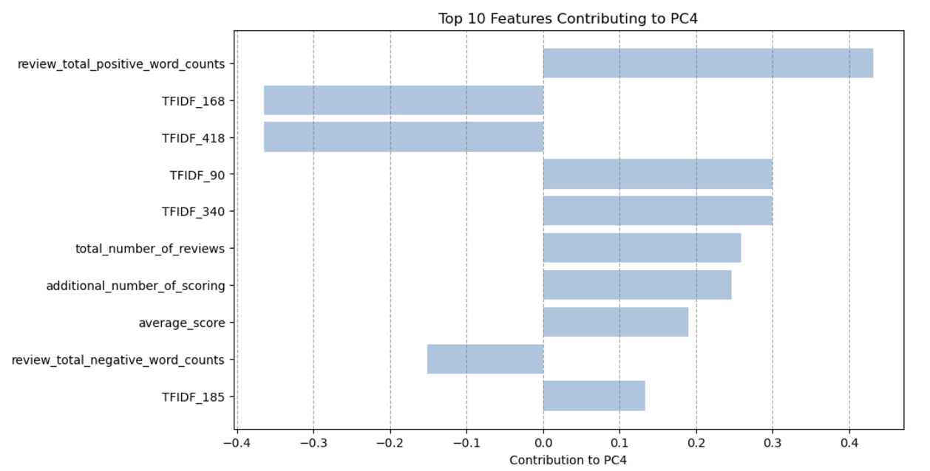
Feature Analysis from Decision Tree Model

Slide 54
Feature Analysis from Decision Tree Model
Non-Textual Influencers: Highlights key non-linguistic features like review count and average score, indicating overall engagement and satisfaction trends.
Room and Stay Duration: Nights stayed, and room comfort are critical, pointing to a focus on guest experience over longer stays.
Service and Value Perception: Indicates that service quality and value remain strong predictors of sentiment, essential for consistent guest satisfaction.

Slide 55
Actionable Insights for Improving Customer Experience
Promote Positive Sentiment Drivers: Emphasize qualities such as excellent location, room comfort, and service friendliness in marketing and promotional materials.
Address Key Negative Feedback Areas: Focus on improving value perception by clarifying amenities, managing expectations on location, and providing clear pricing.
Enhance Guest Service Consistency: Invest in training for staff to ensure a consistent, high-quality service experience, especially in guest-facing roles.
Prioritize Comfort and Room Quality: Enhance bedding, room cleanliness, and modern amenities to improve the comfort experience, particularly for longer stays.

Slide 56
Actionable Insights for Improving Customer Experience
Collect and Leverage Detailed Feedback: Encourage guests to provide detailed reviews to capture comprehensive feedback for ongoing improvements
.Regularly Monitor Sentiment Trends: Establish quarterly reviews of sentiment-driven terms and feedback to stay responsive to changing guest priorities.
Tailor Amenities for Different Demographics: Use demographic insights to align offerings with specific guest needs, improving personalization and satisfaction.

Slide 57
Future Work and Improvements
Scaling to Large Datasets: Implement more efficient data processing techniques and explore parallel computing options to handle larger datasets seamlessly, improving model performance and training times.
Enhanced Model Calibration: Experiment with advanced calibration techniques, such as isotonic regression or Platt scaling, to improve probability estimates and refine prediction accuracy.
Broader Sentiment Analysis: Incorporate advanced NLP techniques like sentiment scoring models (e.g., BERT, RoBERTa) to capture subtler sentiment nuances and explore deeper contextual analysis in reviews.

Slide 58
Future Work and Improvements
Explore Additional Text-Based Features: Identify sentiment indicators beyond n-grams, such as specific customer preferences or emotional tone, to gain a richer understanding of guest satisfaction drivers.
Automated Feature Selection and Tuning: Implement automated feature selection and hyperparameter tuning methods, like AutoML or Bayesian optimization, to streamline model optimization.
Real-Time Feedback Loop: Design a real-time review analysis dashboard to allow Hospitality Insights Group to monitor and respond to guest sentiment continuously, supporting rapid improvements and proactive service adjustments.

Slide 59

Thank you for giving me the opportunity to present to you!

